Slide 1
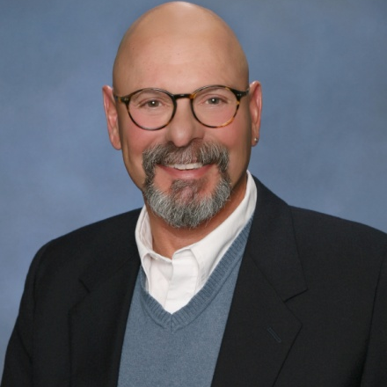
Sex-ACT: unleash the power of your sexual mind with acceptance and commitment therapy
Dr Rich Blonna
William Paterson University
drrich@drrichblonna.com
www.sex-acttraining.com

Slide 2

SEX: Your most powerful erogenous zone is between your ears in your mind, not your legs.

Slide 3

Acceptance and commitment therapy: can help you unleash the power of your sexual mind by understanding and accepting your sexual thinking.

Slide 4
YOUR MIND: Your mind is a 24/7 thinking and feeling machine capable of cranking out an endless stream of sexual thoughts, personal scripts, mental images and emotions.

Slide 5
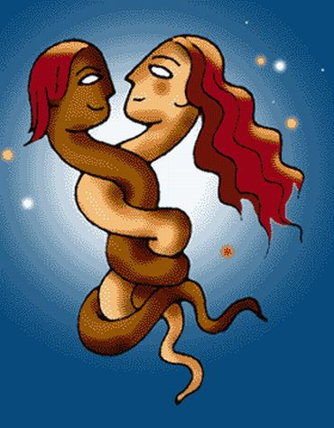
SEXUAL THINKING: Some of what your mind tells you about your sexuality is very helpful in meeting your values-congruent sexual goals.
.

Slide 6

SEXUAL THINKING: and some of what it tells you is not very helpful and can contribute to getting stuck in a sexual rut.

Slide 7

Helpful thoughts, personal scripts, mental images and emotions: support your sexual values and values-congruent goals

Slide 8
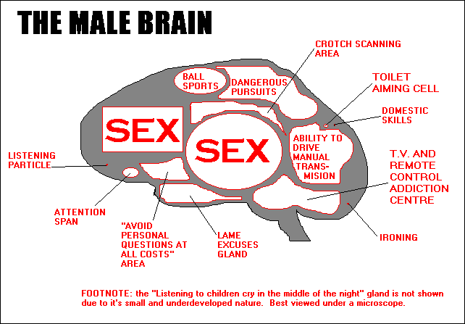
Your Sexual Mind: Many of those thoughts and feelings revolve around some aspect of your sexual identity as a male or female.

Slide 9

Sexual Identity: there are four dimensions of your sexual identity:
(1) biological sex
(2) gender identity
(3) gender role
(4) sexual orientation

Slide 10

Biological Sex: Your sexual anatomy and physiology influence your sexual identity throughout your life.
Ex: Females’ ability to conceive, carry a pregnancy to term, give birth, and breast feed an infant makes them very different from biological males

Slide 11

Gender Identity: your gender identity is your internal picture of what it means to be a man or woman (or neither).
.

Slide 12
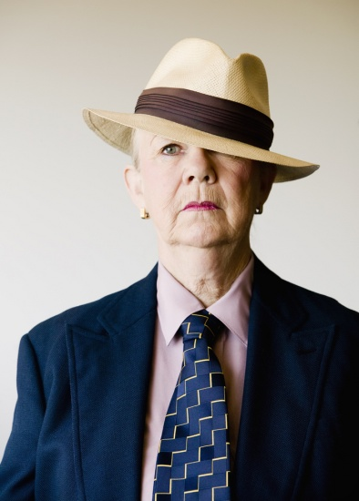
Gender Role: your gender role is your external portrayal (your behavior) of your gender identity.

Slide 13

SEXUAL ORIENTATION: your sexual orientation is your adult, free choice of sexual partners (who you desire and who you have sex with).
Photo: Gandolfo Cannatella / Shutterstock.com

Slide 14
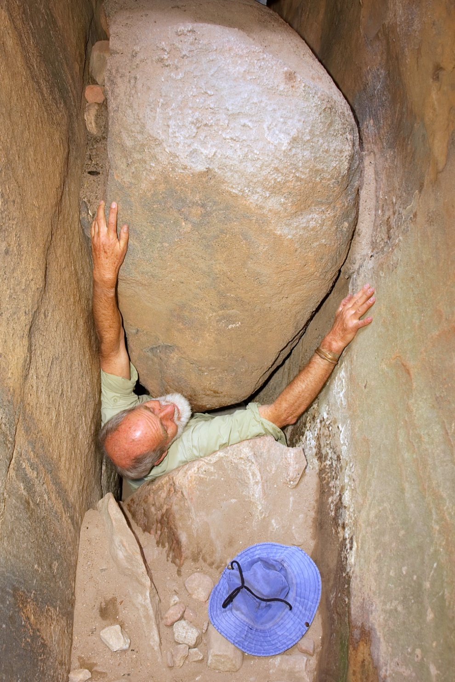
Getting Stuck: We get stuck sexually when we fuse with outdated and unhelpful sexual thoughts, personal scripts, mental images and emotions that serve as barriers to our true sexual values and goals.

Slide 15

Getting Unstuck: breaking through barriers starts with identifying sexual values and setting values-congruent goals that represent who we are and where we want to go.

Slide 16

Getting Unstuck: Continues with mindfulness training.
Becoming more mindful of both internal and external factors.

Slide 17

Getting Unstuck: Involves taking committed action, not just thinking about your goals. This involves realizing that you can’t figure everything out in your head. You must experience life.

Slide 18

Getting Unstuck: Continues with acceptance and willingness training. Learning how to co-exist with unhelpful thoughts and lack of control while taking values-congruent action.

Slide 19

Getting Unstuck: Involves defusing from outdated sexual thoughts, personal scripts, and mental images. Realizing that you always carry these things around in your mind but you do not have to let them control your present and future action.

Slide 20

In Closing: your sexuality is a powerful life force that you can unleash whenever you choose to despite the unhelpful sexual baggage you (and I) carry around. You can drop the bags and move forward committing to the sexual life you want and deserve or you can let the bags weigh you down and keep you stuck.

